Slide 1
An Introduction to R
Day 1

Slide 2
Agenda – Day 1
Primary data structures in R
Vectors
Matrices
Data Frame
Lists
How to create different data structures in R ?
How to access specific elements in data structures (Matrices, Data Frames and Lists)

Slide 3


An Introduction to data structures in R
Just like other programming languages C and C++, R also has different types of data structures. The primary data structures in R are
1).Vectors
2).Matrices
3).Data Frames and
4).Lists
1).Vectors:
Most Simplest structure in R
If data has only one dimension, like a set of digits, then vectors can be used to represent it
1).Matrices:
Used when data is a higher dimensional array
But contains only data of a single class Eg : only character or numeric

Slide 4
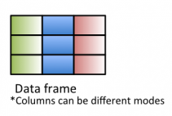

An Introduction to data structures in R
3).Data Frames:
It is a single table with rows and columns of data
Can contain columns of different datatypes/class
4).Lists:
Lists are recursive vectors. Can handle different data types
Very Flexible

Slide 5

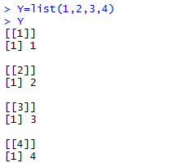
How to create different data structures in R ? (1/5)
Vectors: Most simplest data structure in R . Can handle only one data type
Lists : Recursive vectors. Can handle different data types
Let us create a vector x with numeric values 1,2,3,4 - Can handle only one data type
Let us create the same four elements 1,2,3,4 as a list and have a look at the out put
We can clearly see that the outputs are 1,2,3,4 in the form of list. The representation of data here is quite different from vectors

Slide 6
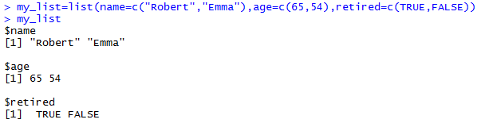

How to create different data structures in R ? (2/5)
Let us create a more complicated list with the variables name, age and retired
How to get values out of my.list?
Suppose if we want to take a look at only age the age elements in the list. The way to get it out is by using $ symbol
What if we want to access only the value belonging to my age component. This is when we have to use the square bracket and traverse by choosing the first element of age component
Instead of [1] if we give [2] R will give the value 54 from age component

Slide 7



How to create different data structures in R ? (3/5)
Matrices: A single table with multiple rows and columns of data but it contains only single type of data (i.e. either numbers or characters)
Matrix has to be created by using the matrix () and by passing the parameters: nrow and ncol
Suppose if we want to create a 3X2 matrix means we have to pass the parameters nrow = 3 and ncol = 2 then we have to simple pass all the 6 (3x2) values in the correct dimension by using the combined operator
Please Note : If we give more than 6 values (3X2=6) then R will throw an error
How to access the elements in the matrices?
Elements in the matrices can be accessed through [1,2] brackets
The value before the comma (i.e. 1) represents the row element and the value after the comma (i.e. 2) represents the column elements
2 ^{nd} Column
3rd Row

Slide 8

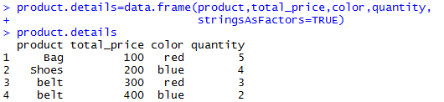
How to create different data structures in R ? (4/5)
Data Frames: A single table with rows and columns of data. Each column can be of different data types
Now let us see how to create a data frame using data.frame () from multiple vectors
Data frame :
We can clearly see that fours columns (product, total_price, color and quantity) have been created from four different vectors

Slide 9

How to create different data structures in R ? (5/5)
How to access the elements in the data frame?
Elements in the data frame can be accessed through [1,2] brackets
The value before the comma (i.e. 1) represents the row and the value after the comma (i.e. 2) represents the column
4 ^{th} Column
4th Row

